Slide 1
Piecewise-linear transformation
Contrast stretching
Goal:
Increase the dynamic range of the gray levels for low contrast images
Low-contrast images can result from
  poor illumination
  lack of dynamic range in the imaging sensor
  wrong setting of a lens aperture during image acquisition
COMSATS University Islamabad, Lahore Campus Digital Image Processing CSD 331

Slide 2
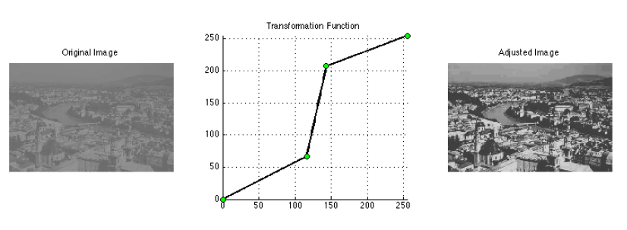
Piecewise-linear transformation
COMSATS University Islamabad, Lahore Campus Digital Image Processing CSD 331

Slide 3
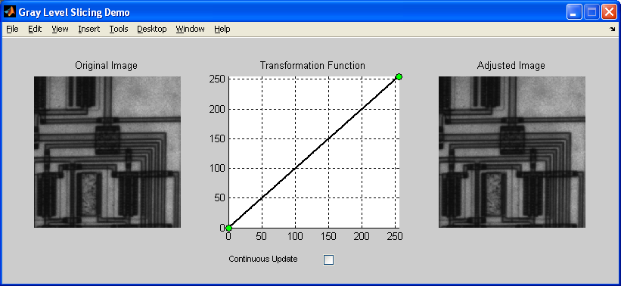
Piecewise-linear transformation
Specifying point transformations interactively
  glsdemo
COMSATS University Islamabad, Lahore Campus Digital Image Processing CSD 331

Slide 4
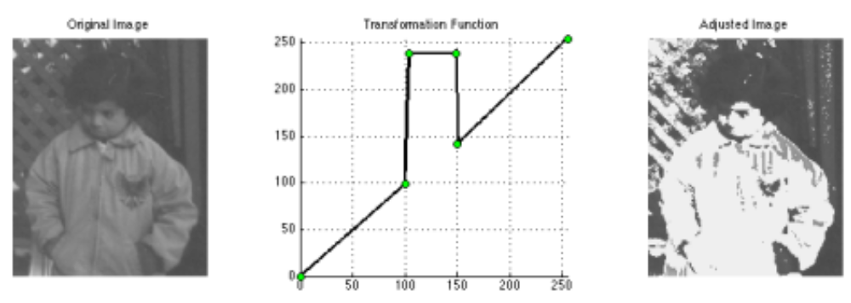
Piecewise-linear transformation (Intensity Level Slicing)
Specifying point transformations interactively
  glsdemo example
COMSATS University Islamabad, Lahore Campus Digital Image Processing CSD 331

Slide 5
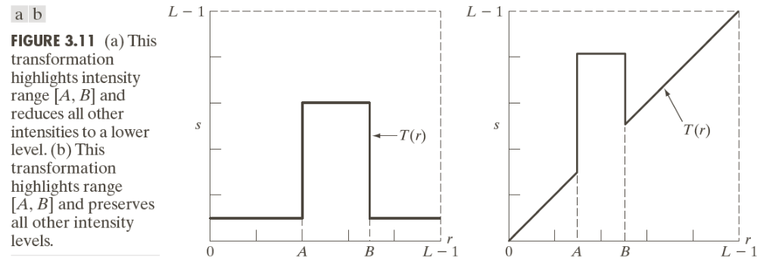
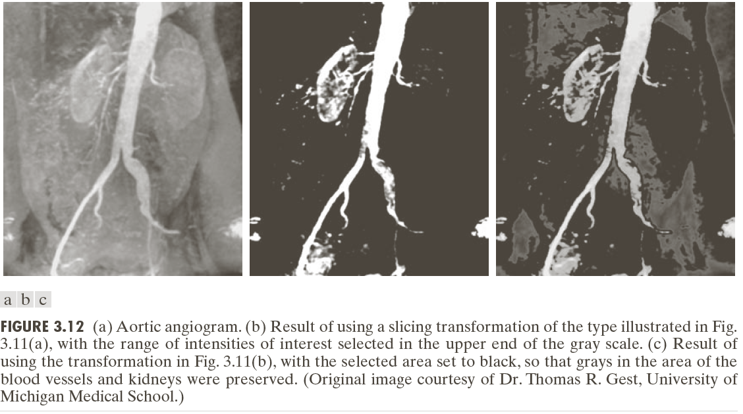
Piecewise-linear transformation (Intensity Level Slicing)
COMSATS University Islamabad, Lahore Campus Digital Image Processing CSD 331

Slide 6
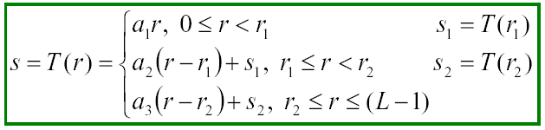
Piecewise-linear transformation: contrast stretching
Method
where a₁, a₂, and a₃ control the result of contrast stretching
if a₁ = a₂ = a₃ = 1 no change in gray levels
if a₁ = a₃ = 0 and r₁ = r₂, T(*) is a thresholding function,
the result is a binary image
Identity
COMSATS University Islamabad, Lahore Campus Digital Image Processing CSD 331

Slide 7

Contrast Stretching Example
Form of Transformation function
Original low-contrast image
Result of contrast stretching
Result of thresholding
COMSATS University Islamabad, Lahore Campus Digital Image Processing CSD 331

Slide 8
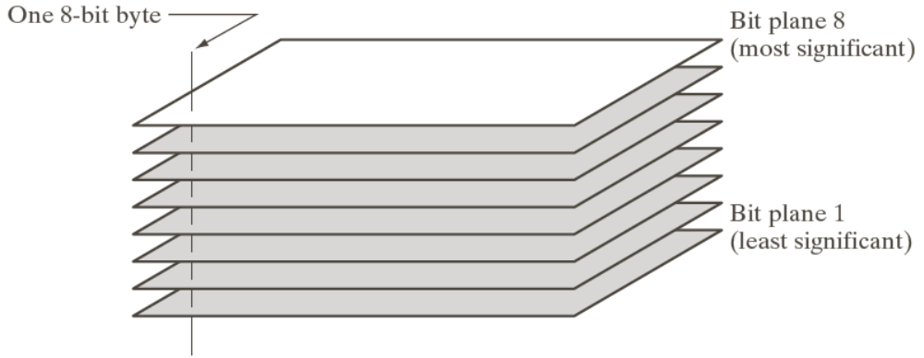

Bit-plane Slicing
COMSATS University Islamabad, Lahore Campus Digital Image Processing CSD 331

Slide 9
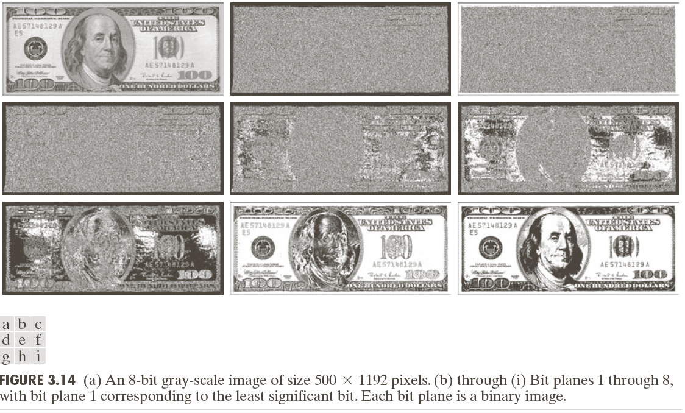
Bit-plane Slicing
Gray Level 194 at border of original image = 11000010
COMSATS University Islamabad, Lahore Campus Digital Image Processing CSD 331

Slide 10
Bit-plane Slicing
In terms of intensity transformation functions :
Binary image for the 8th bit plane of an 8 bit image through a transformation function that maps all intensities between 0 and 127 to 0 and all levels between 128 and 255 to 1.
Exercise: Intensity transformation functions for generating other bit planes
Applications:
  Analyzing the relative importance of each bit in the image
  Determining the adequacy of the no. of bits used to quantize
  Useful for image compression, where fewer than all planes used in reconstruction of an image
COMSATS University Islamabad, Lahore Campus Digital Image Processing CSD 331

Slide 11
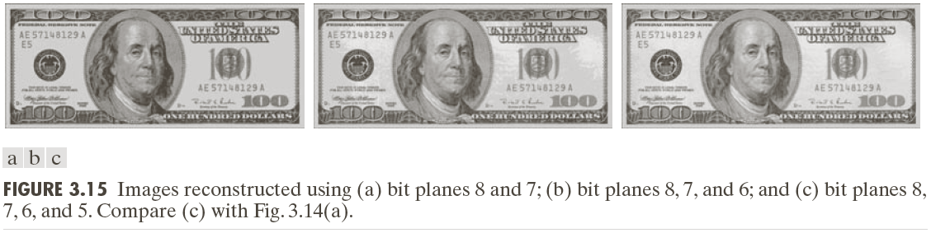
Bit-plane Slicing
Reconstruction done by multiplying pixels of n^{th} plane by a constant 2^{n-1} (Binary to Decimal conversion)
Each plane used, multiplied by corresponding constant and all planes used are added to obtain gray scale images.
COMSATS University Islamabad, Lahore Campus Digital Image Processing CSD 331

Slide 12
Example:
Bit planes for 3-bit image
0 | 2 | 0 | 3
3 | 4 | 0 | 0
2 | 0 | 2 | 3
4 | 1 | 1 | 2
LSB
2²
2¹
MSB
2⁰
0 | 0 | 0 | 0
0 | 1 | 0 | 0
0 | 0 | 0 | 0
1 | 0 | 0 | 0
0 | 1 | 0 | 1
1 | 0 | 0 | 0
1 | 0 | 1 | 1
0 | 0 | 0 | 1
0 | 0 | 0 | 1
1 | 0 | 0 | 0
0 | 0 | 0 | 1
0 | 1 | 1 | 0
COMSATS University Islamabad, Lahore Campus Digital Image Processing CSD 331

Slide 13
Getting specific bit from binary bit plane:
Obtain All the original values of each slice from binary slices.
Multiply the matrix by 2^{b-1} where ‘b’ is the bit position required
b=3
2²
b=2
2¹
b=1
2⁰
0 | 0 | 0 | 0
0 | 1 | 0 | 0
0 | 0 | 0 | 0
1 | 0 | 0 | 0
0 | 1 | 0 | 1
1 | 0 | 0 | 0
1 | 0 | 1 | 1
0 | 0 | 0 | 1
0 | 0 | 0 | 1
1 | 0 | 0 | 0
0 | 0 | 0 | 1
0 | 1 | 1 | 0
x2²
x2¹
x2⁰
0 | 0 | 0 | 0
0 | 4 | 0 | 0
0 | 0 | 0 | 0
4 | 0 | 0 | 0
0 | 2 | 0 | 2
2 | 0 | 0 | 0
2 | 0 | 2 | 2
0 | 0 | 0 | 2
0 | 0 | 0 | 1
1 | 0 | 0 | 0
0 | 0 | 0 | 1
0 | 1 | 1 | 0
COMSATS University Islamabad, Lahore Campus Digital Image Processing CSD 331

Slide 14
Implementation:
% Read the image
image = imread('your_image_path');
image = rgb2gray(image); % Convert to grayscale if necessary
% Extract the last two bit planes
bit_plane_1 = bitand(image, 2); % Extracts the second-to-last bit plane
bit_plane_2 = bitand(image, 1); % Extracts the last bit plane
% Display the original image and the bit planes
subplot(2, 2, 1);
imshow(image);
title('Original Image’);
subplot(2, 2, 3);
imshow(bit_plane_1);
title('Second-to-Last Bit Plane');
subplot(2, 2, 4);
imshow(bit_plane_2);
title('Last Bit Plane');
COMSATS University Islamabad, Lahore Campus Digital Image Processing CSD 331

Slide 15
Problem:
NASA wants to send images which requires only 2 bits possible due to less bandwidth and latency. You are required to send last two-bit planes of 8-bit actual image.
For this problem, convert image into its binary and separate each plane and multiply 2nd last matrix with 2⁶ to get 6th bit and MSB matrix with 2⁷ to get 7th bit.
Note: For 8-bit image, range will be 0-7.
COMSATS University Islamabad, Lahore Campus Digital Image Processing CSD 331

Slide 16
Transformation representation
Display a transformation function which will display most significant bit (MSB) of 8-bit image
1
1
2
4
16
32
64
128
255
Intensity will be 1 if value of image is between 128 and 255 else 0
COMSATS University Islamabad, Lahore Campus Digital Image Processing CSD 331

Slide 17
Problem
How to check 1st bit plane (LSB) is zero or one??
Answer: if number is even, it means least significant bit is 1 otherwise 0
2 = 0010, 3 = 0011
COMSATS University Islamabad, Lahore Campus Digital Image Processing CSD 331

Slide 18
Hiding image:
We can also hide image details by various methods.
Let we want security when sending an image via wireless network. We can create a system using bit planes.
Replace LSB of original image with MSB of another image containing message. When image is received then multiply image by 2⁷ to get original 7th bit plane.
Actual image
Message
LSB
MSB
Received image* 2⁷
COMSATS University Islamabad, Lahore Campus Digital Image Processing CSD 331

